Slide 1
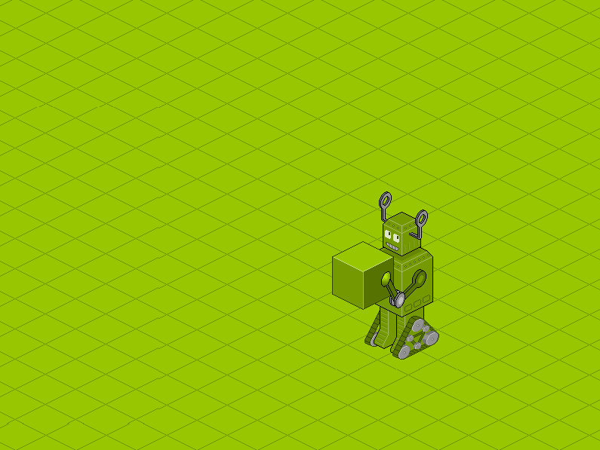
Giovanni Vigorelli
Software Specialist
Introduction to
SWAGGER
Notes:
Good tuorial: http://idratherbewriting.com/pubapis_swagger/
Good afternoon, I am Giovanni and I am a software specialist. I know it doesn’t mean anything but that’s what I do for living. Helping organization to solve problems using software.
The guy is the picture is not by brother, it’s actually me, I grew some beard to get more credibility in the Development community.
This should be a vendor-free Event (a part from Vendor paying to make it happen) so I won’t tell you who is my employer, and I’ll never say the name throughout the session, but the first person who will amazingly guess that will receive as price this delicious coffe-chocolates that I smuggle into NZ via my mother in low.

Slide 2

Be respectful to one another
Respect yourself, and respect others.
Unwelcome behaviour will not be tolerated whether to other attendees, organisers, venue staff or other patrons of the APIDays NZ venues. Unwelcome behaviours include intimidation, harassment, abusive, discriminatory or derogatory conduct by any attendees of APIDays NZ and related events. All APIDays NZ venues may be shared with members of the public; please be respectful to all patrons of these locations.
Be careful. Please keep an eye out for dangerous activity or situations, and alert the conference team if you become aware of any safety hazards.
If we were at Amazon...
Everybody must use API (“Anyone who doesn't do this will be fired”)
We mustn’t use PowerPoint
Notes:
Few important, out of context, things before start the.
Coming to the event you all agreed to the Code of Conduct (you have read and accepted right??). Basically they say to nice to each other. SO! IF you are thinking ‘how the hell is talking this guy?? What accent is that??” You have been racist and this is not accepted. So, just understand me without complaining.
While preparing the material for this presentation, I looked around for API stuff and of course I found many anecdotes about Amazon.
I believe we all know about the “Jeff Bezos moment”
And then I found that At Amazon PowerPoint is banned.
Meetings last 1 or 1.5h, the first 30 minutes attendees read the paper written by the presenter, the they discuss…

Slide 3
OpenAPI Specification (fka Swagger RESTful API Documentation Specification) Version 2.0 The key words "MUST", "MUST NOT", "REQUIRED", "SHALL", "SHALL NOT", "SHOULD", "SHOULD NOT", "RECOMMENDED", "MAY", and "OPTIONAL" in this document are to be interpreted as described in RFC 2119. The Swagger specification is licensed under The Apache License, Version 2.0. Introductions Swagger™ is a project used to describe and document RESTful APIs. The Swagger specification defines a set of files required to describe such an API. These files can then be used by the Swagger-UI project to display the API and Swagger-Codegen to generate clients in various languages. Additional utilities can also take advantage of the resulting files, such as testing tools. Revision History Version Date Notes 2.0 2014-09-08 Release of Swagger 2.0 1.2 2014-03-14 Initial release of the formal document. 1.1 2012-08-22 Release of Swagger 1.1 1.0 2011-08-10 First release of the Swagger Specification Definitions Path Templating Path templating refers to the usage of curly braces ({}) to mark a section of a URL path as replaceable using path parameters. Mime Types Mime type definitions are spread across several resources. The mime type definitions should be in compliance with RFC 6838. Some examples of possible mime type definitions: text/plain; charset=utf-8 application/json application/vnd.github+json application/vnd.github.v3+json application/vnd.github.v3.raw+json application/vnd.github.v3.text+json application/vnd.github.v3.html+json application/vnd.github.v3.full+json application/vnd.github.v3.diff application/vnd.github.v3.patch HTTP Status Codes The HTTP Status Codes are used to indicate the status of the executed operation. The available status codes are described by RFC 7231 and in the IANA Status Code Registry. Specification Format The files describing the RESTful API in accordance with the Swagger specification are represented as JSON objects and conform to the JSON standards. YAML, being a superset of JSON, can be used as well to represent a Swagger specification file. For example, if a field is said to have an array value, the JSON array representation will be used: { "field" : [...] } While the API is described using JSON it does not impose a JSON input/output to the API itself. All field names in the specification are case sensitive. The schema exposes two types of fields. Fixed fields, which have a declared name, and Patterned fields, which declare a regex pattern for the field name. Patterned fields can have multiple occurrences as long as each has a unique name. File Structure The Swagger representation of the API is made of a single file. However, parts of the definitions can be split into separate files, at the discretion of the user. This is applicable for $ref fields in the specification as follows from the JSON Schema definitions. By convention, the Swagger specification file is named swagger.json. Data Types Primitive data types in the Swagger Specification are based on the types supported by the JSON-Schema Draft 4. Models are described using the Schema Object which is a subset of JSON Schema Draft 4. An additional primitive data type "file" is used by the Parameter Object and the Response Object to set the parameter type or the response as being a file. Primitives have an optional modifier property format. Swagger uses several known formats to more finely define the data type being used. However, the format property is an open string-valued property, and can have any value to support documentation needs. Formats such as "email", "uuid", etc., can be used even though they are not defined by this specification. Types that are not accompanied by a format property follow their definition from the JSON Schema (except for file type which is defined above). The formats defined by the Swagger Specification are: Common Name type format Comments integer integer int32 signed 32 bits long integer int64 signed 64 bits float number float double number double string string byte string byte base64 encoded characters binary string binary any sequence of octets boolean boolean date string date As defined by full-date - RFC3339 dateTime string date-time As defined by date-time - RFC3339 password string password Used to hint UIs the input needs to be obscured. Schema Swagger Object This is the root document object for the API specification. It combines what previously was the Resource Listing and API Declaration (version 1.2 and earlier) together into one document. Fixed Fields Field Name Type Description swagger string Required. Specifies the Swagger Specification version being used. It can be used by the Swagger UI and other clients to interpret the API listing. The value MUST be "2.0". info Info Object Required. Provides metadata about the API. The metadata can be used by the clients if needed. host string The host (name or ip) serving the API. This MUST be the host only and does not include the scheme nor sub-paths. It MAY include a port. If the host is not included, the host serving the documentation is to be used (including the port). The host does not support path templating. basePath string The base path on which the API is served, which is relative to the host. If it is not included, the API is served directly under the host. The value MUST start with a leading slash (/). The basePath does not support path templating. schemes [string] The transfer protocol of the API. Values MUST be from the list: "http", "https", "ws", "wss". If the schemes is not included, the default scheme to be used is the one used to access the Swagger definition itself. consumes [string] A list of MIME types the APIs can consume. This is global to all APIs but can be overridden on specific API calls. Value MUST be as described under Mime Types. produces [string] A list of MIME types the APIs can produce. This is global to all APIs but can be overridden on specific API calls. Value MUST be as described under Mime Types. paths Paths Object Required. The available paths and operations for the API. definitions Definitions Object An object to hold data types produced and consumed by operations. parameters Parameters Definitions Object An object to hold parameters that can be used across operations. This property does not define global parameters for all operations. responses Responses Definitions Object An object to hold responses that can be used across operations. This property does not define global responses for all operations. securityDefinitions Security Definitions Object Security scheme definitions that can be used across the specification. security [Security Requirement Object] A declaration of which security schemes are applied for the API as a whole. The list of values describes alternative security schemes that can be used (that is, there is a logical OR between the security requirements). Individual operations can override this definition. tags [Tag Object] A list of tags used by the specification with additional metadata. The order of the tags can be used to reflect on their order by the parsing tools. Not all tags that are used by the Operation Object must be declared. The tags that are not declared may be organized randomly or based on the tools' logic. Each tag name in the list MUST be unique. externalDocs External Documentation Object Additional external documentation. Patterned Objects Field Pattern Type Description ^x- Any Allows extensions to the Swagger Schema. The field name MUST begin with x-, for example, x-internal-id. The value can be null, a primitive, an array or an object. See Vendor Extensions for further details. Info Object The object provides metadata about the API. The metadata can be used by the clients if needed, and can be presented in the Swagger-UI for convenience. Fixed Fields Field Name Type Description title string Required. The title of the application. description string A short description of the application. GFM syntax can be used for rich text representation. termsOfService string The Terms of Service for the API. contact Contact Object The contact information for the exposed API. license License Object The license information for the exposed API. version string Required Provides the version of the application API (not to be confused with the specification version). Patterned Objects Field Pattern Type Description ^x- Any Allows extensions to the Swagger Schema. The field name MUST begin with x-, for example, x-internal-id. The value can be null, a primitive, an array or an object. See Vendor Extensions for further details. Info Object Example: { "title": "Swagger Sample App", "description": "This is a sample server Petstore server.", "termsOfService": "http://swagger.io/terms/", "contact": { "name": "API Support", "url": "http://www.swagger.io/support", "email": "support@swagger.io" }, "license": { "name": "Apache 2.0", "url": "http://www.apache.org/licenses/LICENSE-2.0.html" }, "version": "1.0.1" } title: Swagger Sample App description: This is a sample server Petstore server. termsOfService: http://swagger.io/terms/ contact: name: API Support url: http://www.swagger.io/support email: support@swagger.io license: name: Apache 2.0 url: http://www.apache.org/licenses/LICENSE-2.0.html version: 1.0.1 Contact Object Contact information for the exposed API. Fixed Fields Field Name Type Description name string The identifying name of the contact person/organization. url string The URL pointing to the contact information. MUST be in the format of a URL. email string The email address of the contact person/organization. MUST be in the format of an email address. Patterned Objects Field Pattern Type Description ^x- Any Allows extensions to the Swagger Schema. The field name MUST begin with x-, for example, x-internal-id. The value can be null, a primitive, an array or an object. See Vendor Extensions for further details. Contact Object Example: { "name": "API Support", "url": "http://www.swagger.io/support", "email": "support@swagger.io" } name: API Support url: http://www.swagger.io/support email: support@swagger.io License Object License information for the exposed API. Fixed Fields Field Name Type Description name string Required. The license name used for the API. url string A URL to the license used for the API. MUST be in the format of a URL. Patterned Objects Field Pattern Type Description ^x- Any Allows extensions to the Swagger Schema. The field name MUST begin with x-, for example, x-internal-id. The value can be null, a primitive, an array or an object. See Vendor Extensions for further details. License Object Example: { "name": "Apache 2.0", "url": "http://www.apache.org/licenses/LICENSE-2.0.html" } name: Apache 2.0 url: http://www.apache.org/licenses/LICENSE-2.0.html Paths Object Holds the relative paths to the individual endpoints. The path is appended to the basePath in order to construct the full URL. The Paths may be empty, due to ACL constraints. Patterned Fields Field Pattern Type Description /{path} Path Item Object A relative path to an individual endpoint. The field name MUST begin with a slash. The path is appended to the basePath in order to construct the full URL. Path templating is allowed. ^x- Any Allows extensions to the Swagger Schema. The field name MUST begin with x-, for example, x-internal-id. The value can be null, a primitive, an array or an object. See Vendor Extensions for further details. Paths Object Example { "/pets": { "get": { "description": "Returns all pets from the system that the user has access to", "produces": [ "application/json" ], "responses": { "200": { "description": "A list of pets.", "schema": { "type": "array", "items": { "$ref": "#/definitions/pet" } } } } } } } /pets: get:
. It combines what previously was the Resource Listing and API Declaration (version 1.2 and earlier) together into one document. Fixed Fields Field Name Type Description swagger string Required. Specifies the Swagger Specification version being used. It can be used by the Swagger UI and other clients to interpret the API listing. The value MUST be "2.0". info Info Object Required. Provides metadata about the API. The metadata can be used by the clients if needed. host string The host (name or ip) serving the API. This MUST be the host only and does not include the scheme nor sub-paths. It MAY include a port. If the host is not included, the host serving the documentation is to be used (including the port). The host does not support path templating. basePath string The base path on which the API is served, which is relative to the host. If it is not included, the API is served directly under the host. The value MUST start with a leading slash (/). The basePath does not support path templating. schemes [string] The transfer protocol of the API. Values MUST be from the list: "http", "https", "ws", "wss". If the schemes is not included, the default scheme to be used is the one used to access the Swagger definition itself. consumes [string] A list of MIME types the APIs can consume. This is global to all APIs but can be overridden on specific API calls. Value MUST be as described under Mime Types. produces [string] A list of MIME types the APIs can produce. This is global to all APIs but can be overridden on specific API calls. Value MUST be as described under Mime Types. paths Paths Object Required. The available paths and operations for the API. definitions Definitions Object An object to hold data types produced and consumed by operations. parameters Parameters Definitions Object An object to hold parameters that can be used across operations. This property does not define global parameters for all operations. responses Responses Definitions Object An object to hold responses that can be used across operations. This property does not define global responses for all operations. securityDefinitions Security Definitions Object Security scheme definitions that can be used across the specification. security [Security Requirement Object] A declaration of which security schemes are applied for the API as a whole. The list of values describes alternative security schemes that can be used (that is, there is a logical OR between the security requirements). Individual operations can override this definition. tags [Tag Object] A list of tags used by the specification with additional metadata. The order of the tags can be used to reflect on their order by the parsing tools. Not all tags that are used by the Operation Object must be declared. The tags that are not declared may be organized randomly or based on the tools' logic. Each tag name in the list MUST be unique
. It combines what previously was the Resource Listing and API Declaration (version 1.2 and earlier) together into one document. Fixed Fields Field Name Type Description swagger string Required. Specifies the Swagger Specification version being used. It can be used by the Swagger UI and other clients to interpret the API listing. The value MUST be "2.0". info Info Object Required. Provides metadata about the API. The metadata can be used by the clients if needed. host string The host (name or ip) serving the API. This MUST be the host only and does not include the scheme nor sub-paths. It MAY include a port. If the host is not included, the host serving the documentation is to be used (including the port). The host does not support path templating. basePath string The base path on which the API is served, which is relative to the host. If it is not included, the API is served directly under the host. The value MUST start with a leading slash (/). The basePath does not support path templating. schemes [string] The transfer protocol of the API. Values MUST be from the list: "http", "https", "ws", "wss". If the schemes is not included, the default
Notes:
Jeff Bezos moment
At Amazon PowerPoint is banned.
Meetings last 1 or 1.5h, the first 30 minutes attendees read the paper written by the presenter, the they discuss…

Slide 4

A bit of history
We should always learn from past
1462 - First specs released by Leonardo (“ The Da Vinci code”)
2010 - Wordnik started (again) as internal project
2015 - SmartBear (maintainer with other founding members such as Google, IBM and Microsoft) created a new organization called Open API initiative.
2016 - Swagger renamed to Open API Specification and moved to github.
2016 – OpenApi v3 working in progress
Notes:
1_
Flying machine, Armored car, diving suit, machine gun Leonardo was 10, then he met MonnaLisa and API become boring. Hence my Italian accent to make this session more credible
Named swagger to ‘make fun’ of WADL (wodl) which is a funny way to walk.. We don’t wadl, we swgger!

Slide 5


Can we start without a definition?
(Swagger)
Rumors say that Swagger was the answer to WADL (walking like a duck)
How someone presents him or her self to the world. Swagger is shown from how the person handles a situation. It can also be shown in the person's walk.
A person's style- they way they walk, talk, dress.
“I'm loving his swagger!”
http://www.urbandictionary.com/define.php?term=swagger
Notes:
The Web Application Description Language (WADL) is a machine-readable XML description of HTTP-based web services
… the guy is me after work

Slide 6
And now?
(Open API)
Notes:
Same thing, I just needed a new picture

Slide 7

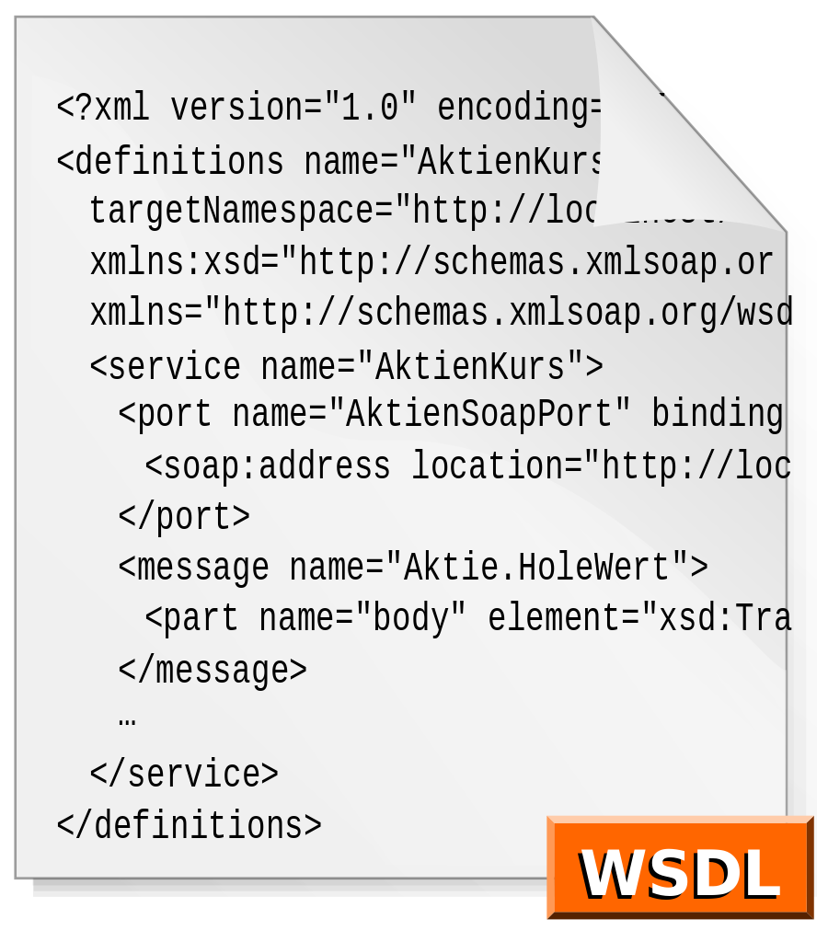
It’s all about making themselves visible
REST Web API is like browsing a web site with your eyes closed!
In the ‘old days’ or in ‘the other room’ there’s WSDL (SOAP web services), complex and ugly as you like, but up for the job
Notes:
If you are old enough to understand what SOAP is, you don’t need me to explain.
If you are young enough to not understand what SOAP is, you probably don’t need to know anything about it… just that it was quite usefu do document web services.

Slide 8

Which problems it tries (successfully) to solve
API discovery
API readability
Development speed up
- client / server decoupling
- creating API from code
- generate code from API
Remove barriers between Business (product owners) and IT (developers)
Notes:
Check if the audience is ‘old’ enough to have seen Pulp Fiction (Mr Wolf – the resolution)

Slide 9
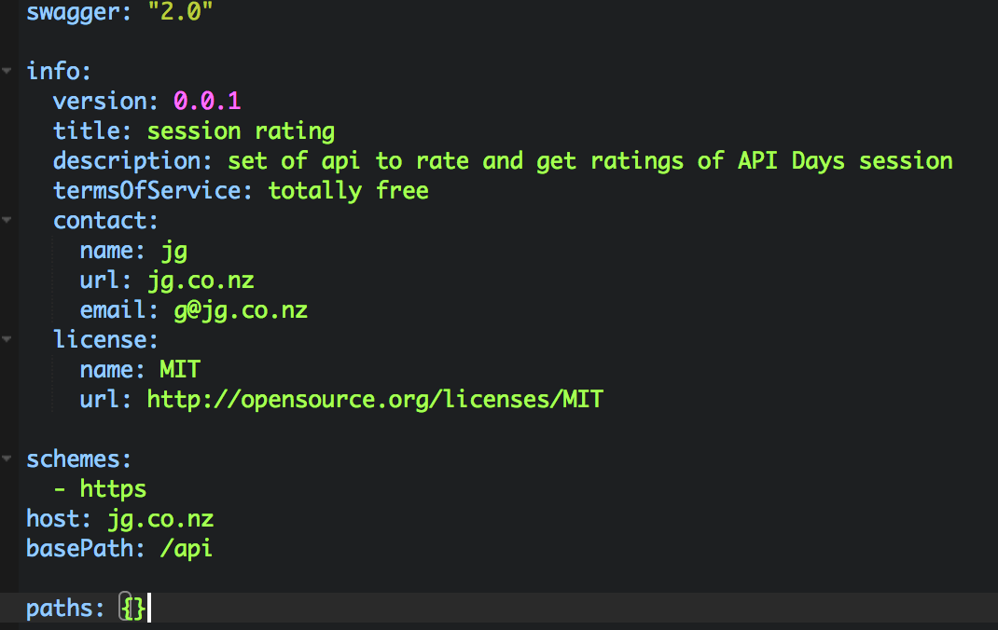
API definition (discovery )
swagger
info
schemes
host
basePath
paths
(JSON or YAML, you chose)
Notes:
swagger: 2.0 version of the Swagger
info: - metadata about the API.
host: - host serving the API
basePath: - base path on which the API is served
schemes: - protocol(s) of the API.
consumes: - A list of MIME types the APIs can consume.
produces: - MIME types the APIs can produce.
paths: - Defines the available operations on the API
definitions: - complex objects

Slide 10
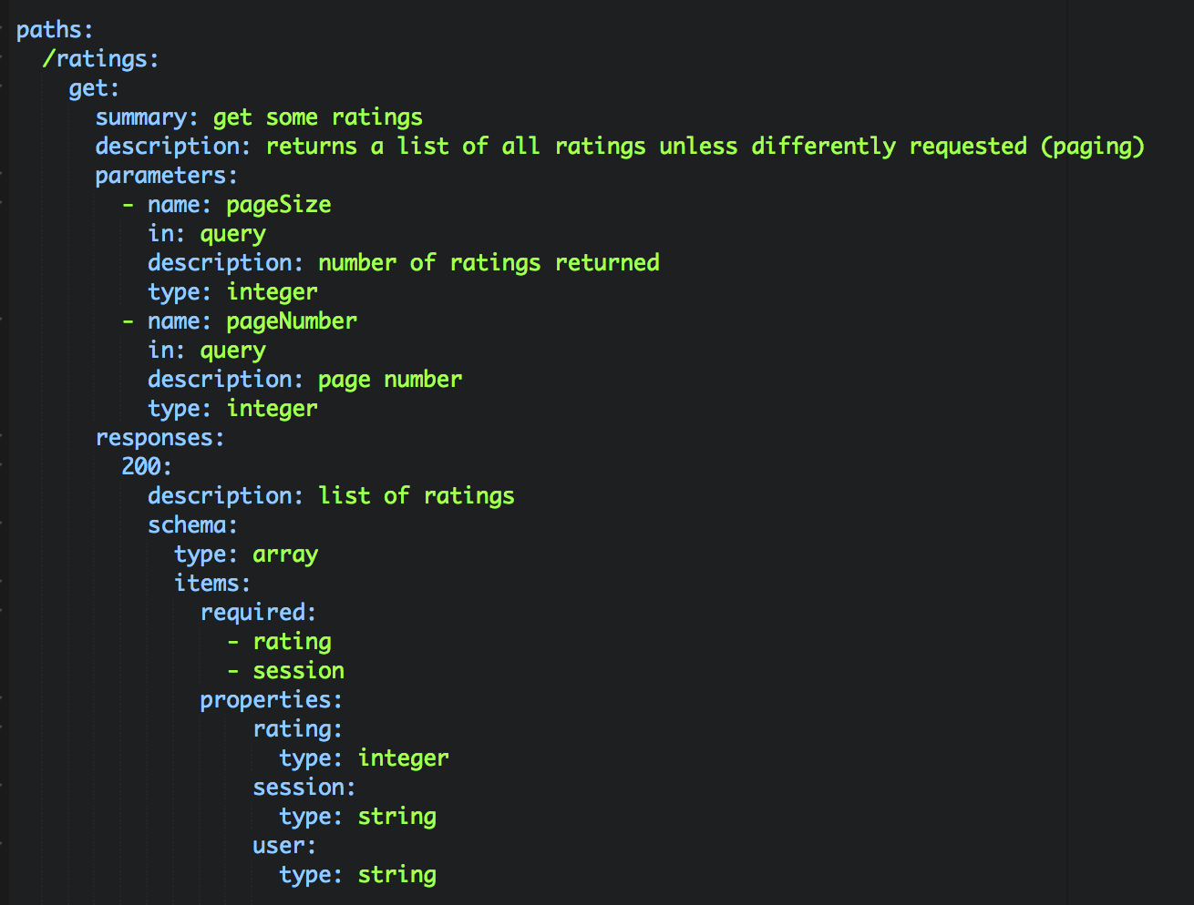
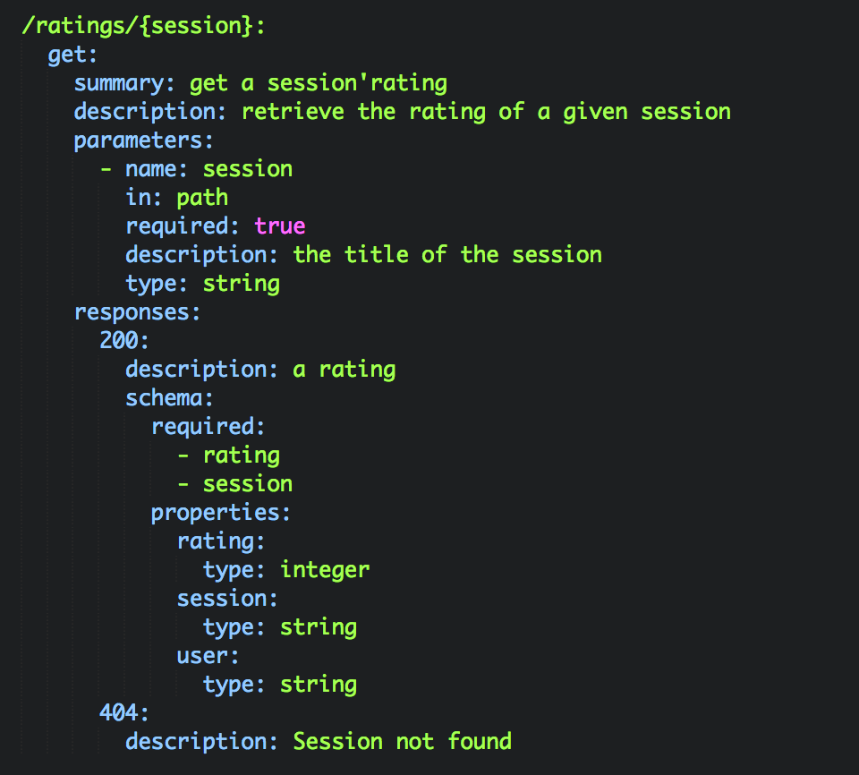
API definition (discovery )
paths
resources
methods
parameters
responses
Notes:
swagger: 2.0 version of the Swagger
info: - metadata about the API.
host: - host serving the API
basePath: - base path on which the API is served
schemes: - protocol(s) of the API.
consumes: - A list of MIME types the APIs can consume.
produces: - MIME types the APIs can produce.
paths: - Defines the available operations on the API
definitions: - complex objects

Slide 11
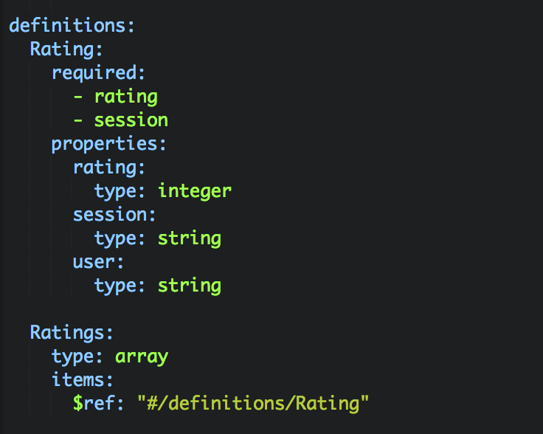
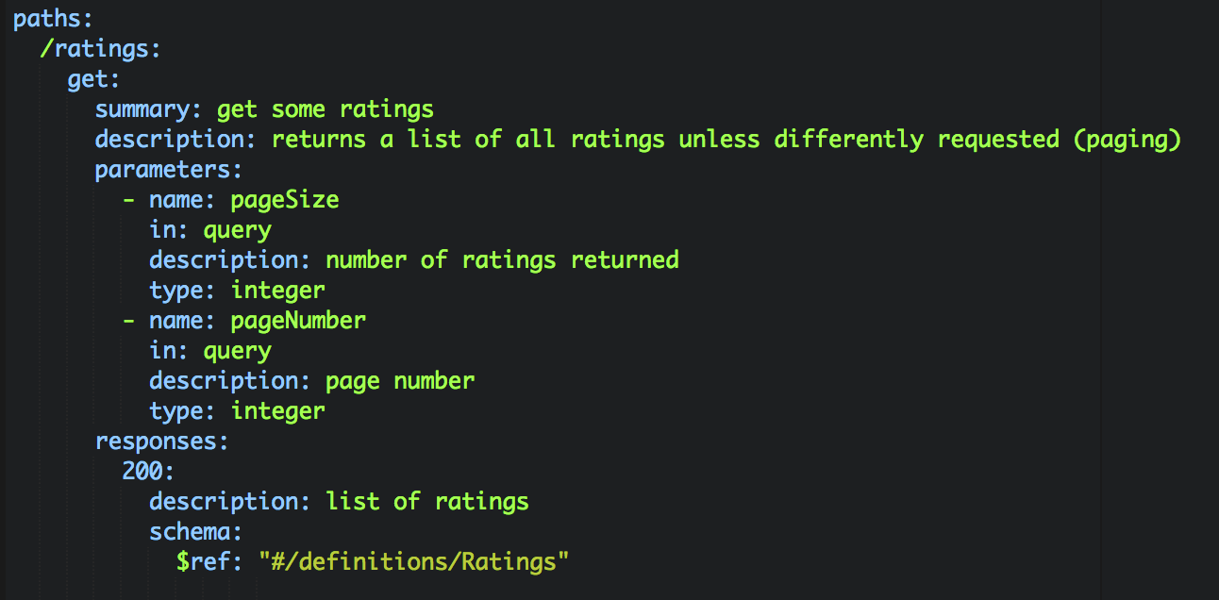
API definition (discovery )
definitions
Notes:
swagger: 2.0 version of the Swagger
info: - metadata about the API.
host: - host serving the API
basePath: - base path on which the API is served
schemes: - protocol(s) of the API.
consumes: - A list of MIME types the APIs can consume.
produces: - MIME types the APIs can produce.
paths: - Defines the available operations on the API
definitions: - complex objects

Slide 12
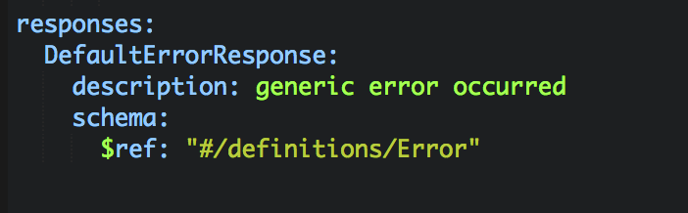
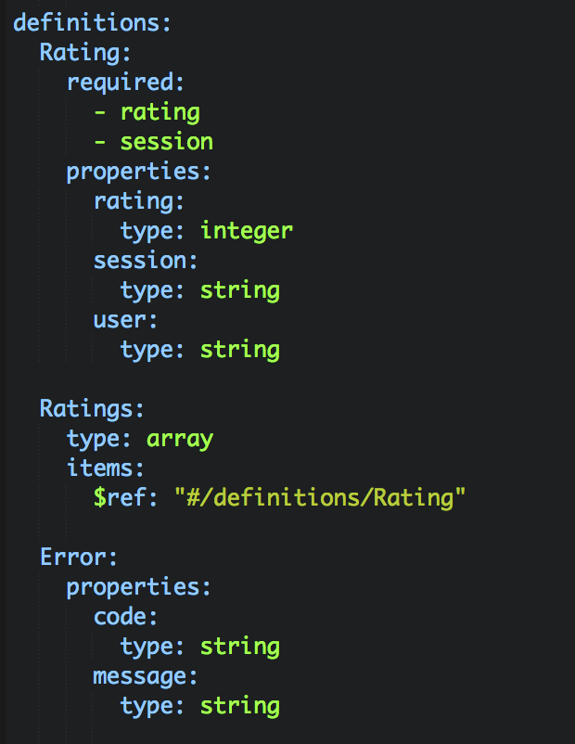
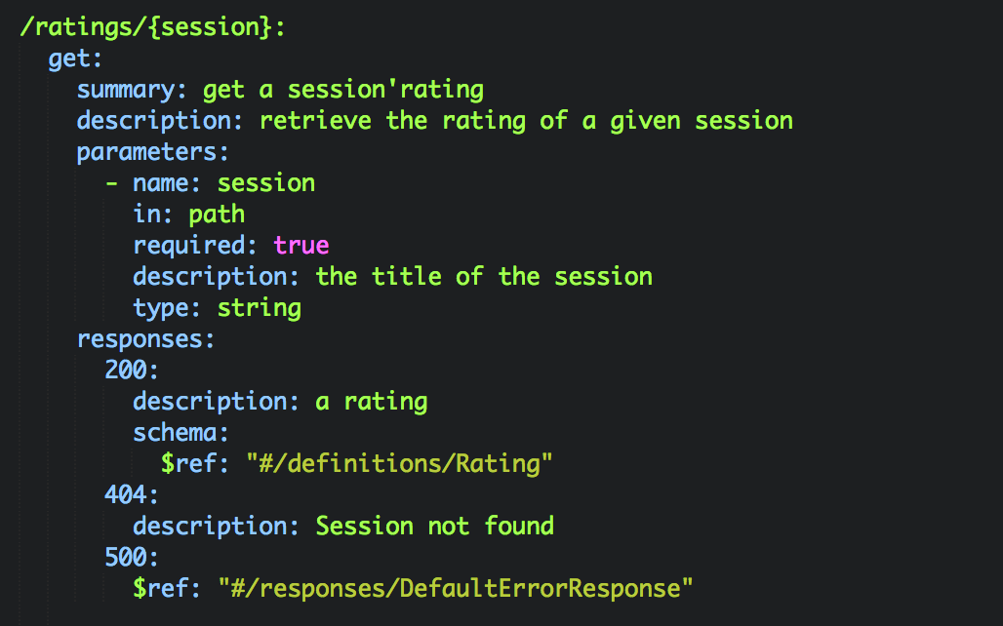
API definition (discovery )
responses
Notes:
swagger: 2.0 version of the Swagger
info: - metadata about the API.
host: - host serving the API
basePath: - base path on which the API is served
schemes: - protocol(s) of the API.
consumes: - A list of MIME types the APIs can consume.
produces: - MIME types the APIs can produce.
paths: - Defines the available operations on the API
definitions: - complex objects

Slide 13
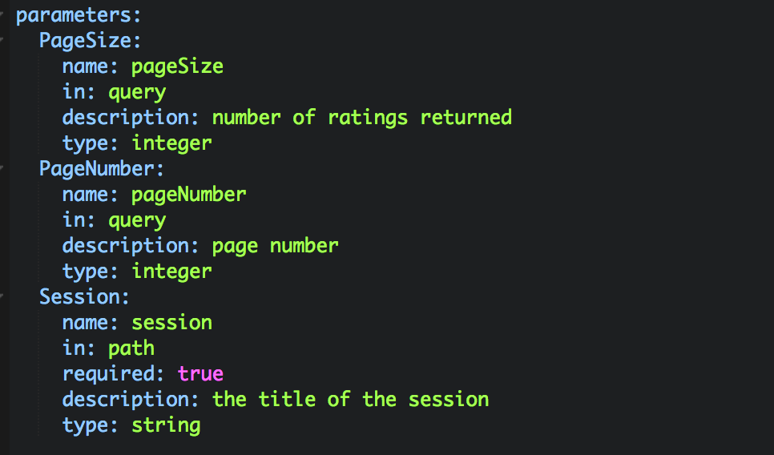
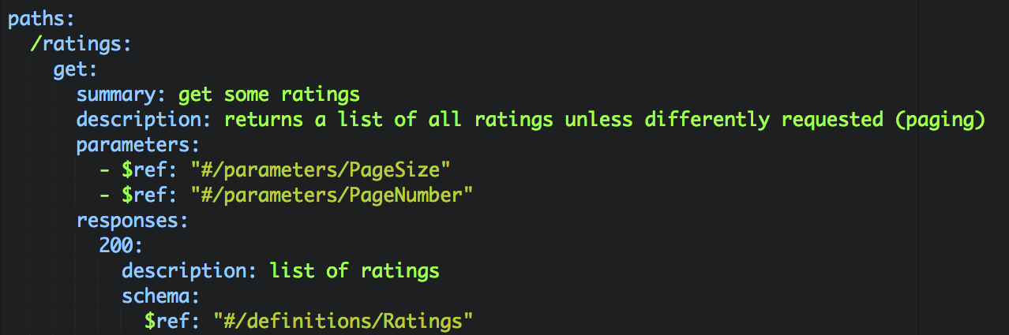
API definition (discovery )
parameters
Notes:
swagger: 2.0 version of the Swagger
info: - metadata about the API.
host: - host serving the API
basePath: - base path on which the API is served
schemes: - protocol(s) of the API.
consumes: - A list of MIME types the APIs can consume.
produces: - MIME types the APIs can produce.
paths: - Defines the available operations on the API
definitions: - complex objects

Slide 14
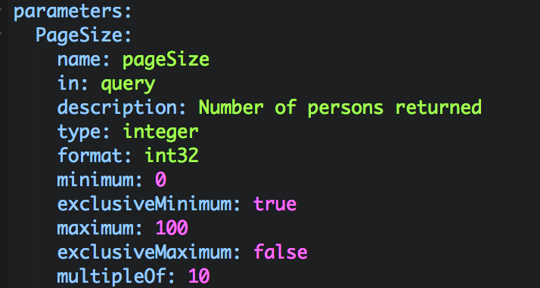
API definition (discovery )
Advanced type definition
Notes:
swagger: 2.0 version of the Swagger
info: - metadata about the API.
host: - host serving the API
basePath: - base path on which the API is served
schemes: - protocol(s) of the API.
consumes: - A list of MIME types the APIs can consume.
produces: - MIME types the APIs can produce.
paths: - Defines the available operations on the API
definitions: - complex objects

Slide 15
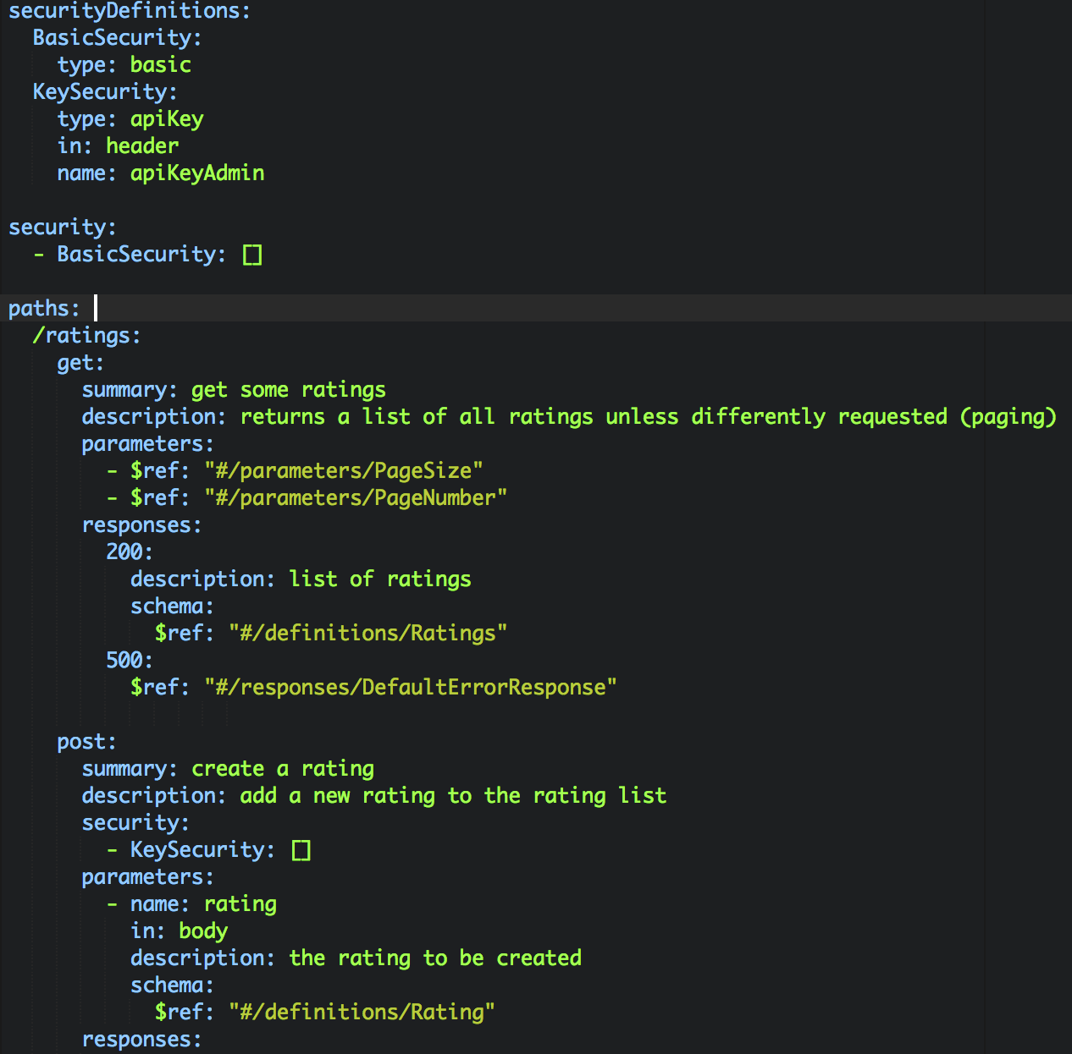
API definition (discovery )
securityDefinitions
security
Notes:
In this case basicSecurity is applied to all resources/operations
KeySecurity is applied to /ratings POST
OAUTH is available:
securityDefinitions:
OauthSecurity:
type: oauth2
flow: accessCode
authorizationUrl: 'https://oauth.simple.api/authorization'
tokenUrl: 'https://oauth.simple.api/token'
scopes:
admin: Admin scope
user: User scope
media: Media scope

Slide 16
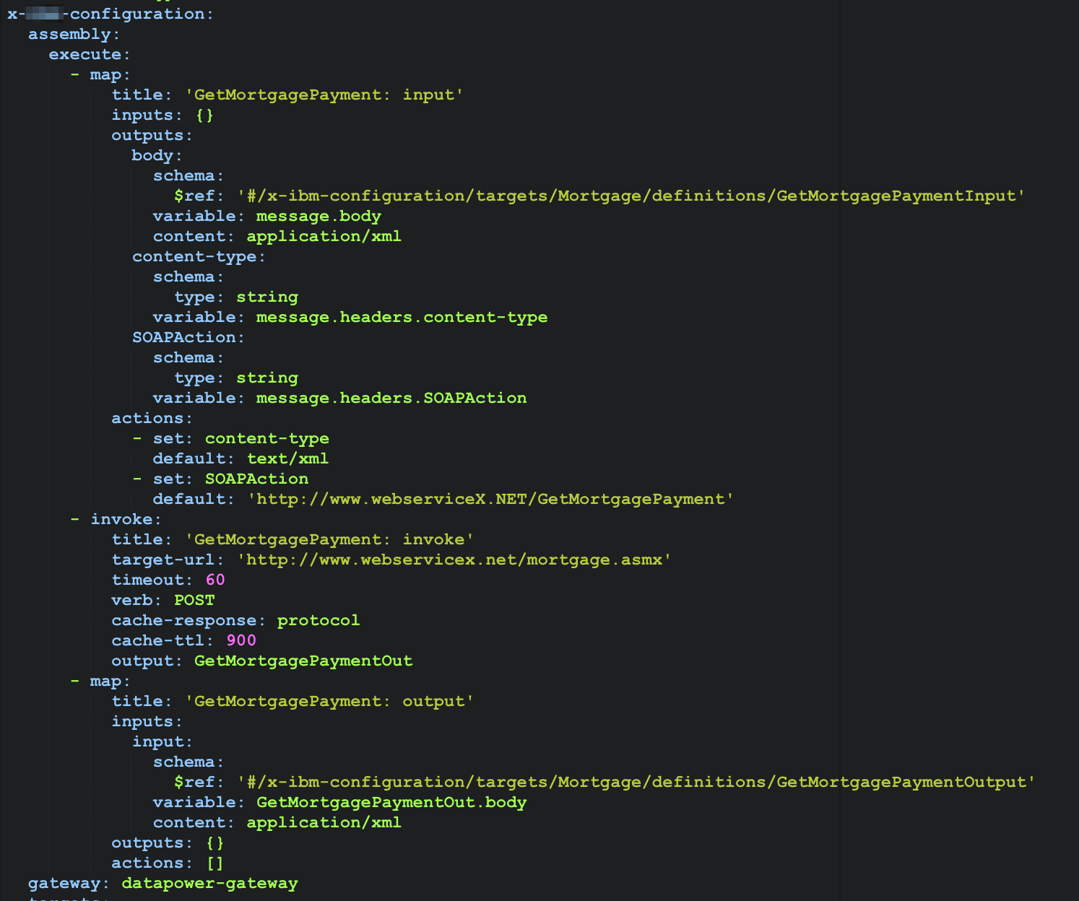
API definition (discovery )
extensions
Notes:
In this case basicSecurity is applied to all resources/operations
KeySecurity is applied to /ratings POST
OAUTH is available:
securityDefinitions:
OauthSecurity:
type: oauth2
flow: accessCode
authorizationUrl: 'https://oauth.simple.api/authorization'
tokenUrl: 'https://oauth.simple.api/token'
scopes:
admin: Admin scope
user: User scope
media: Media scope

Slide 17


Remove Business – Development barriers
Bottom up
Top Down
Identify commercial products
Marketing a product
Design the API
Externalize IT assets
Implement the API logic
Leverage IT legacy
(or build new)
Leverage IT legacy
(or build new)

Slide 18
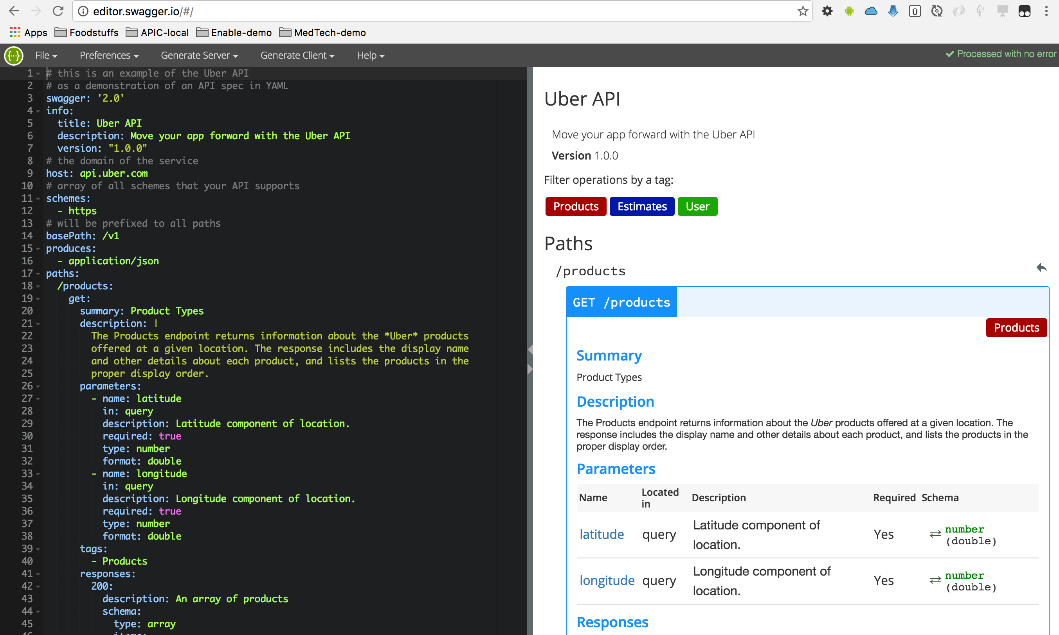
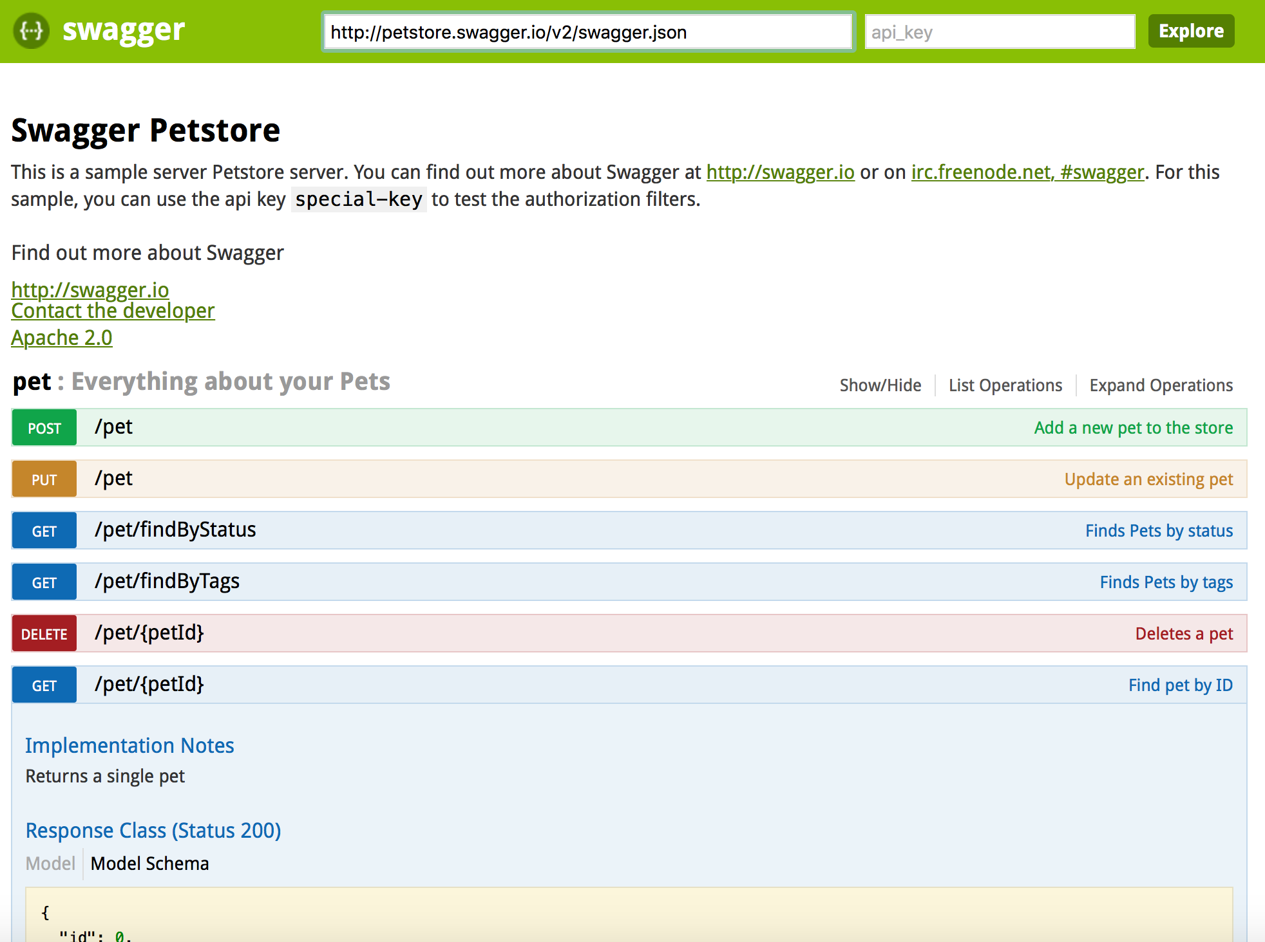
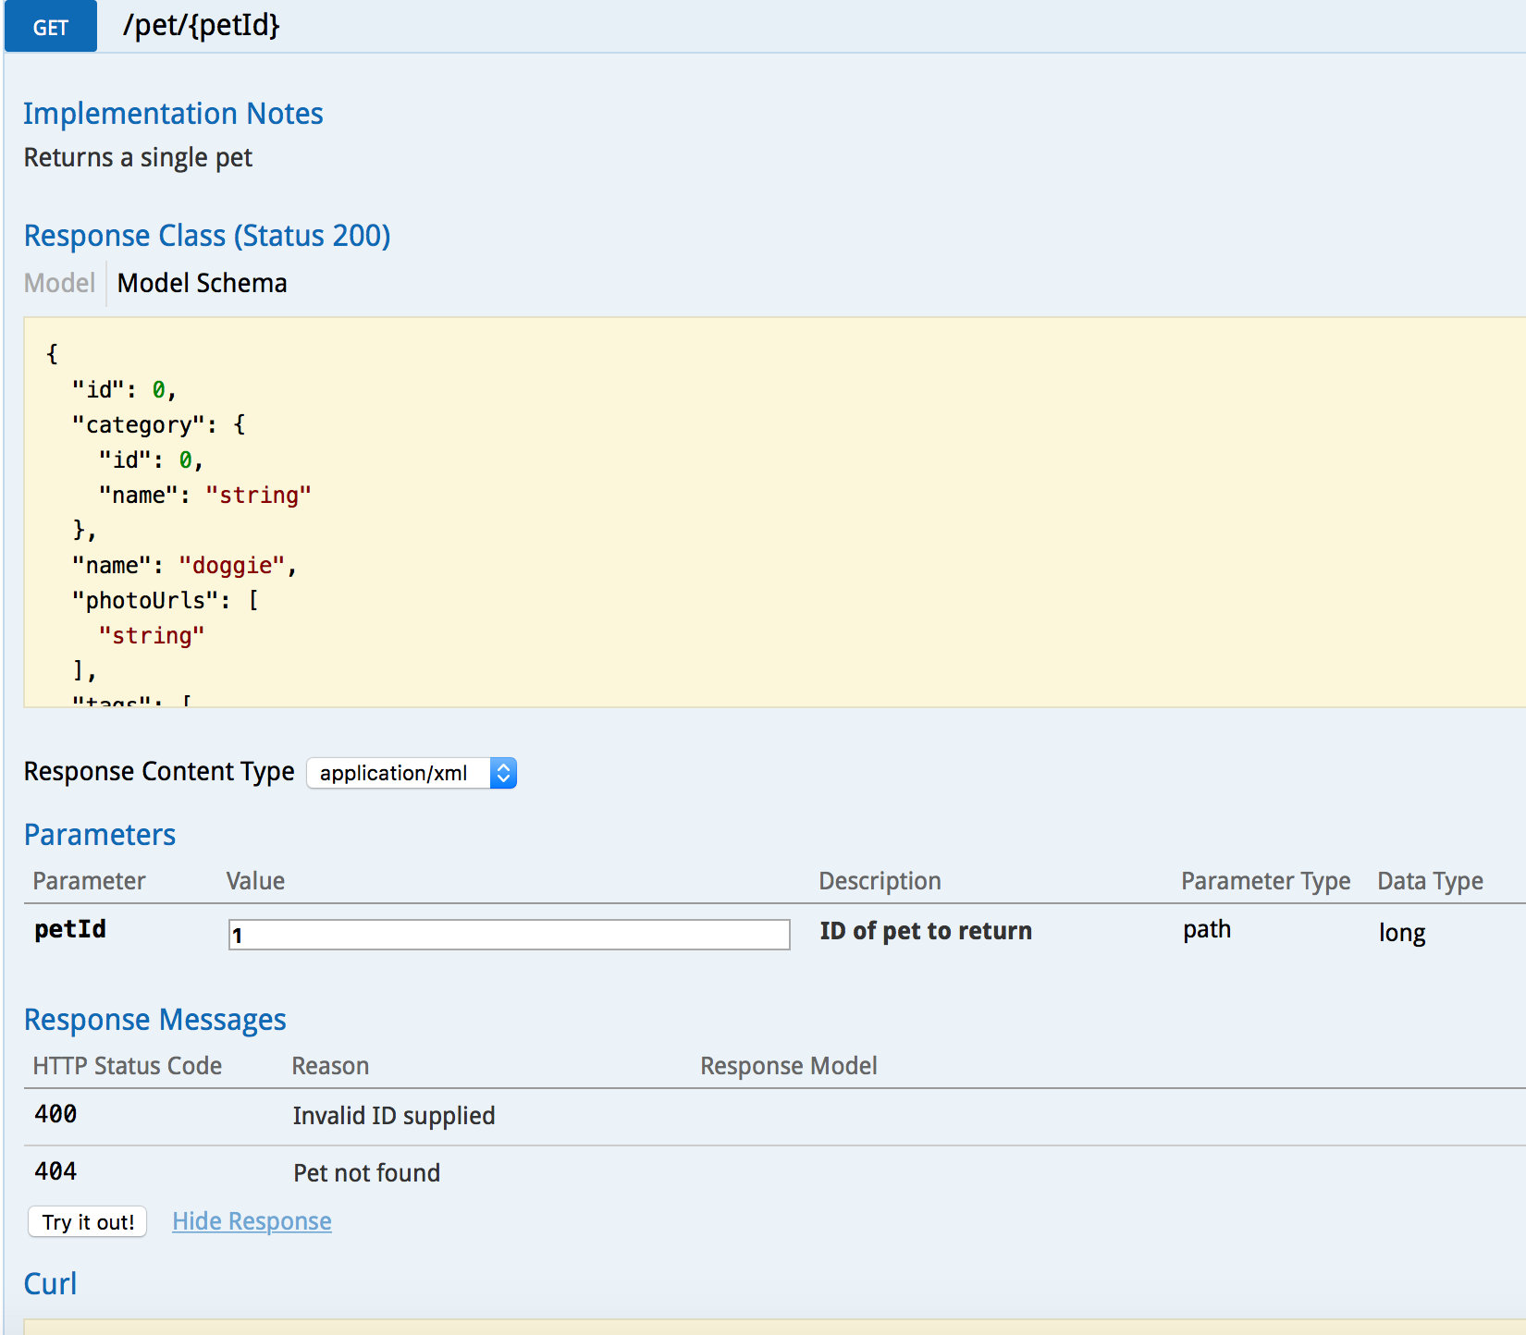
API readability (documentation)
Swagger tools (editor, UI) help to define a standard for REST API documentation.
No more documentation cowboys !

Slide 19
Dev. speed up – client and server decoupling
API definition allows client side developers to create client against swagger definition (codgen or test)
Swagger .json
Mobile, Web, whatever Apps
Business Services
API definition allows server side developers implement the logic to server API resources

Slide 20
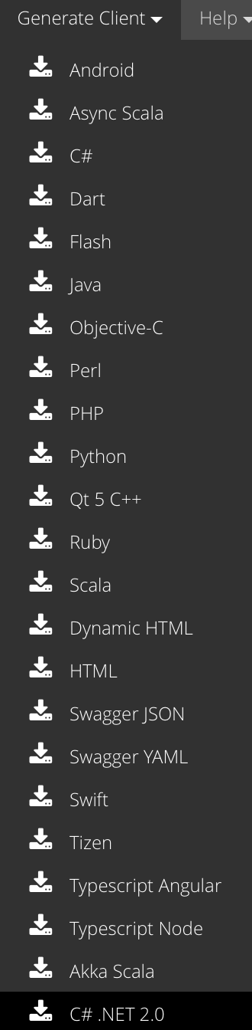
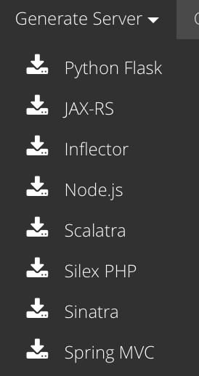

Dev. speed up – Code Generation
Swagger Codegen
Swagger Tools
Swagger JS

Slide 21
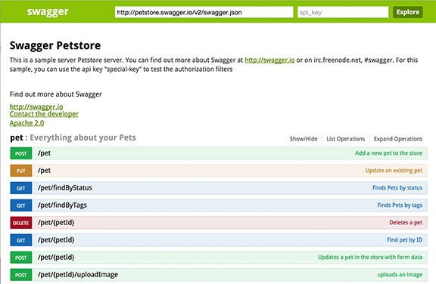


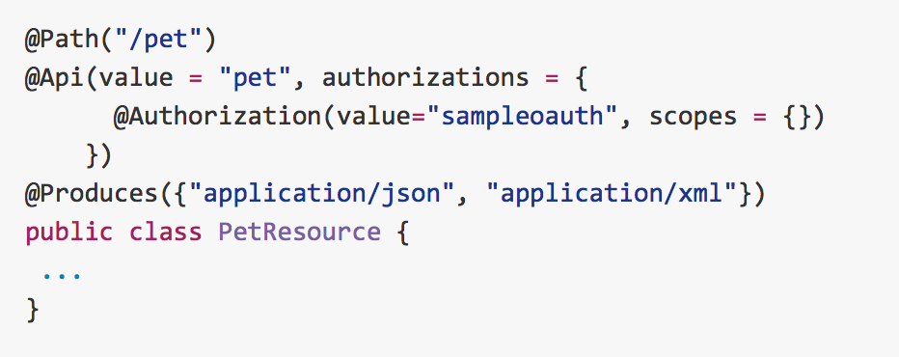
Dev. speed up – API Generation
Swashbuckle
JAX-RS

Slide 22



















100% open source, loved by big players
Notes:
This is the final clue …

Slide 23
100% open source, loved by big players
Notes:
This is the final clue …

Slide 24

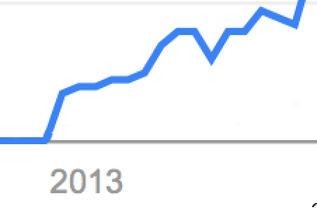

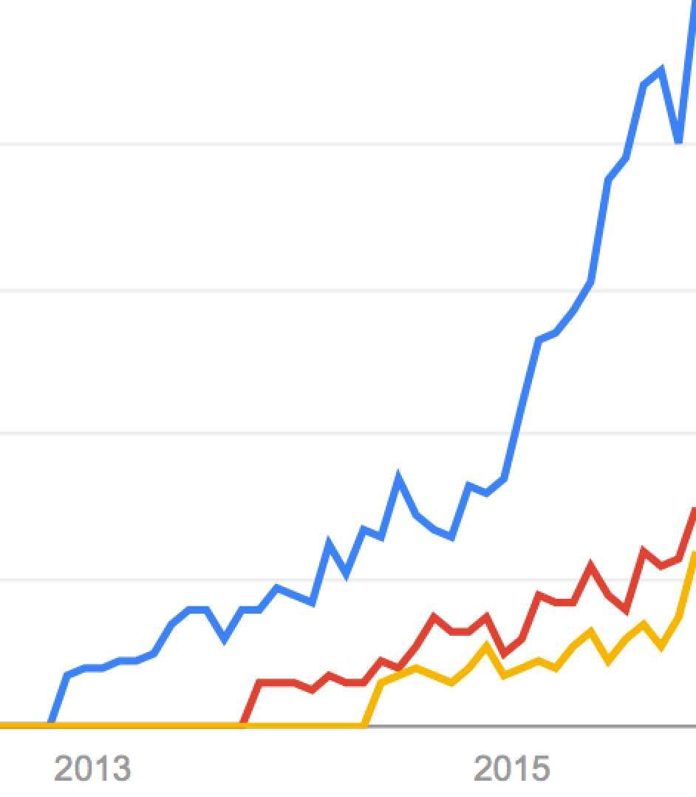
Spec popularity …
RAML api
Swagger api
Blueprint api
… 1 winner!
(if it was a race)
Notes:
But it’s not a race, Swagger is the most popular, but the others are not bad.
Chose one and stick with that.

Slide 25
Notes:
Thanks Giovanni, Great histotrical facts there. Well … as they say “One does not simply swagger!” The API designer in the know uses

Slide 26

Justin Wood
Internet Savant

Slide 27
Is RAML better?
…. (extrapolating)
Yes! …
RAML does not rely on hip-hop parlance for popularity!
Swagger api
RAML api

Slide 28
Is RAML better?
Jokes aside …
it depends …

Slide 29


Slide 30
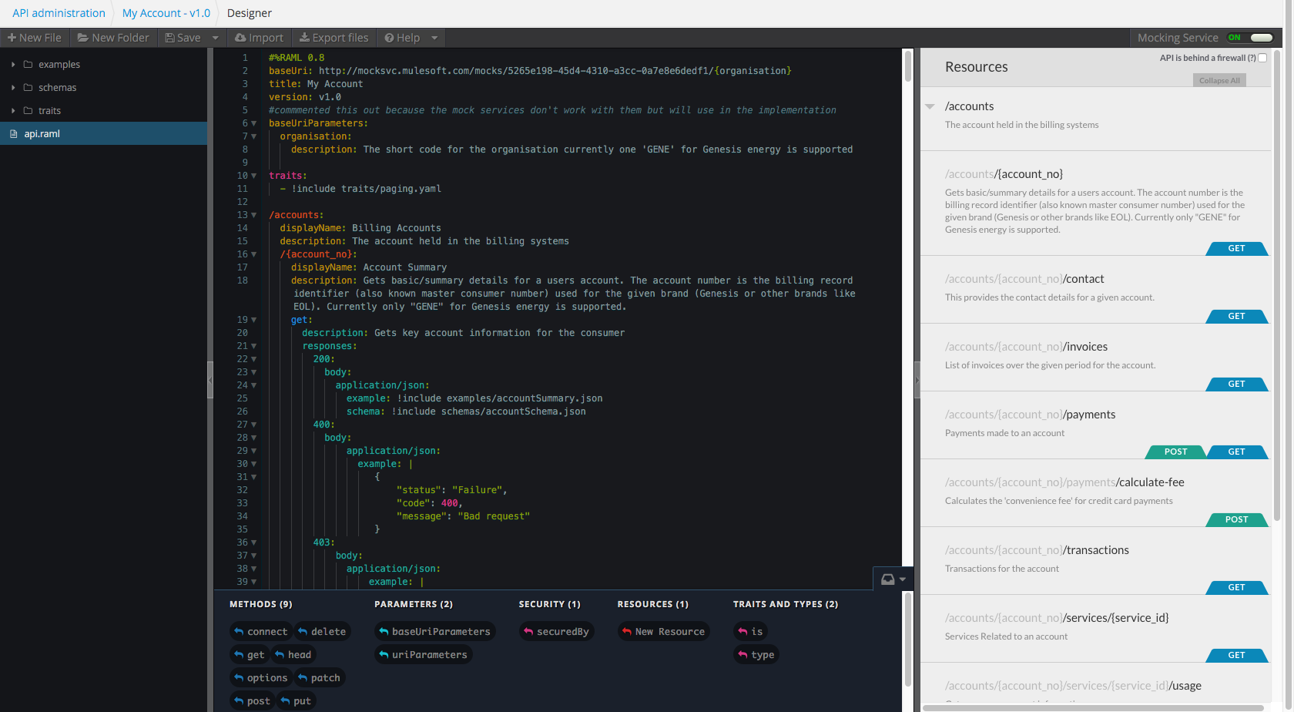
Productive Dev Environment

Slide 31
Well Structured Code
Productive Dev Environment

Slide 32
Well Structured Code
Navigable
Documentation
Productive Dev Environment

Slide 33
Mocking
Well Structured Code
Navigable
Documentation
Productive Dev Environment

Slide 34
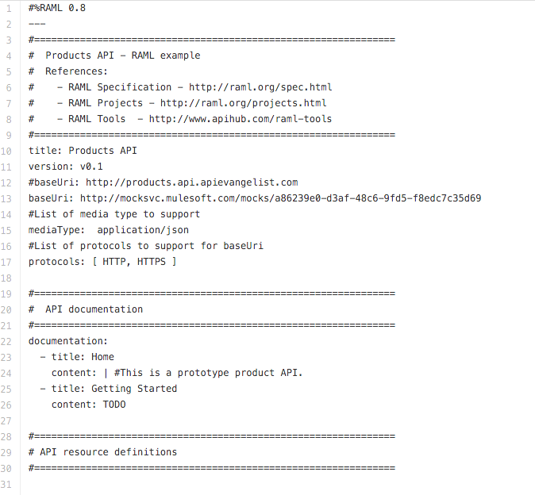
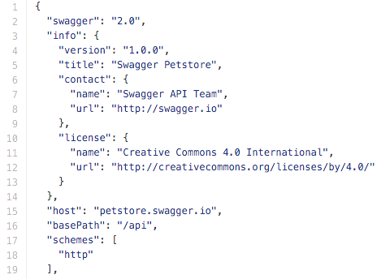
https://github.com/swagger-api/swagger-spec/blob/master/examples/v2.0/json/petstore.json
http://apievangelist.com/2014/03/08/hello-world-product-api-with-blueprint-raml-and-swagger/

Slide 35
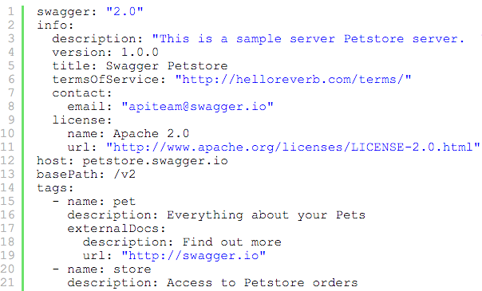
https://github.com/swagger-api/swagger-spec/blob/master/examples/v2.0/json/petstore.json
http://apievangelist.com/2014/03/08/hello-world-product-api-with-blueprint-raml-and-swagger/

Slide 36
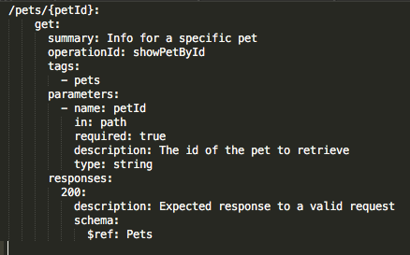
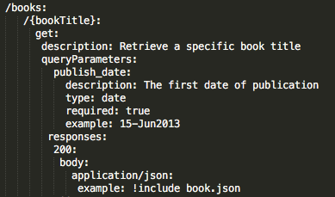
https://github.com/swagger-api/swagger-spec/blob/master/examples/v2.0/json/petstore.json
http://apievangelist.com/2014/03/08/hello-world-product-api-with-blueprint-raml-and-swagger/

Slide 37
https://github.com/swagger-api/swagger-spec/blob/master/examples/v2.0/json/petstore.json
http://apievangelist.com/2014/03/08/hello-world-product-api-with-blueprint-raml-and-swagger/

Slide 38
https://github.com/swagger-api/swagger-spec/blob/master/examples/v2.0/json/petstore.json
http://apievangelist.com/2014/03/08/hello-world-product-api-with-blueprint-raml-and-swagger/

Slide 39
https://github.com/swagger-api/swagger-spec/blob/master/examples/v2.0/json/petstore.json
http://apievangelist.com/2014/03/08/hello-world-product-api-with-blueprint-raml-and-swagger/

Slide 40
https://github.com/swagger-api/swagger-spec/blob/master/examples/v2.0/json/petstore.json
http://apievangelist.com/2014/03/08/hello-world-product-api-with-blueprint-raml-and-swagger/

Slide 41
Choosing an API Design Language/Framework
Bottom up or top down?
What are my target technologies?
Do I need specific features?
What is my team familiar with?
How ‘Cloudy’ do I need to be?
What support model do I need?
Test the tools?
… but remember a good REST service design is what you are really trying to acheive regardless of what language you choose to express it in.

Slide 42
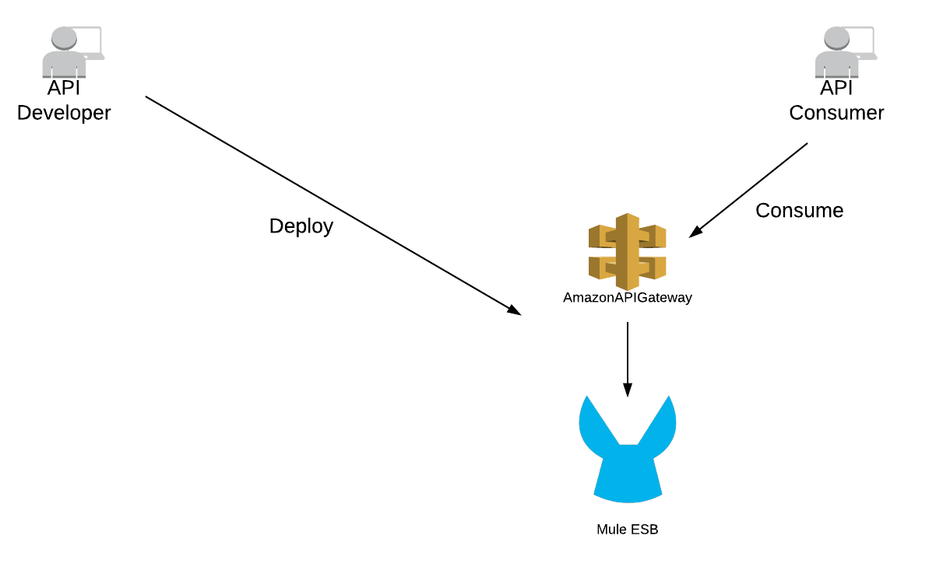
Product Driven Spec Choice
Notes:
This is a problem. API Gateway uses Swagger … Mule uses RAML?
What to do?

Slide 43
Seek technical advice …

Slide 44
Seek technical advice …

Slide 45
Product Driven Spec Choice
Notes:
This is a problem. API Gateway uses Swagger … Mule uses RAML?
What to do?

Slide 46
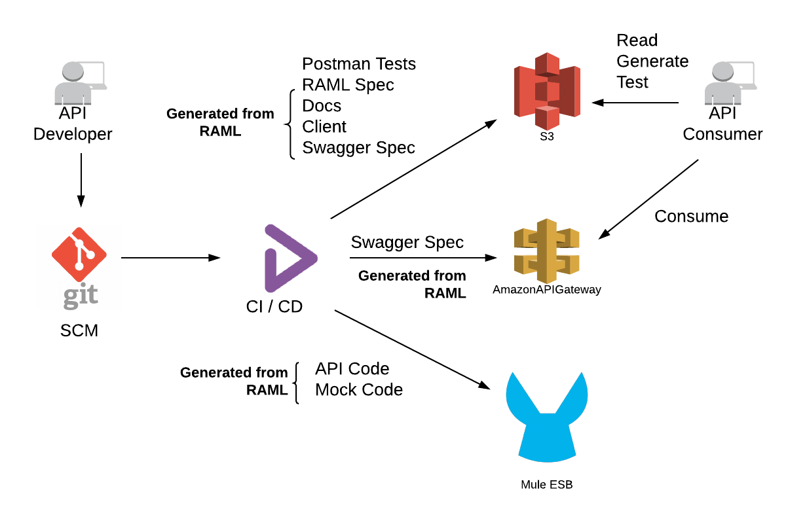
Product Driven Spec Choice

Slide 47
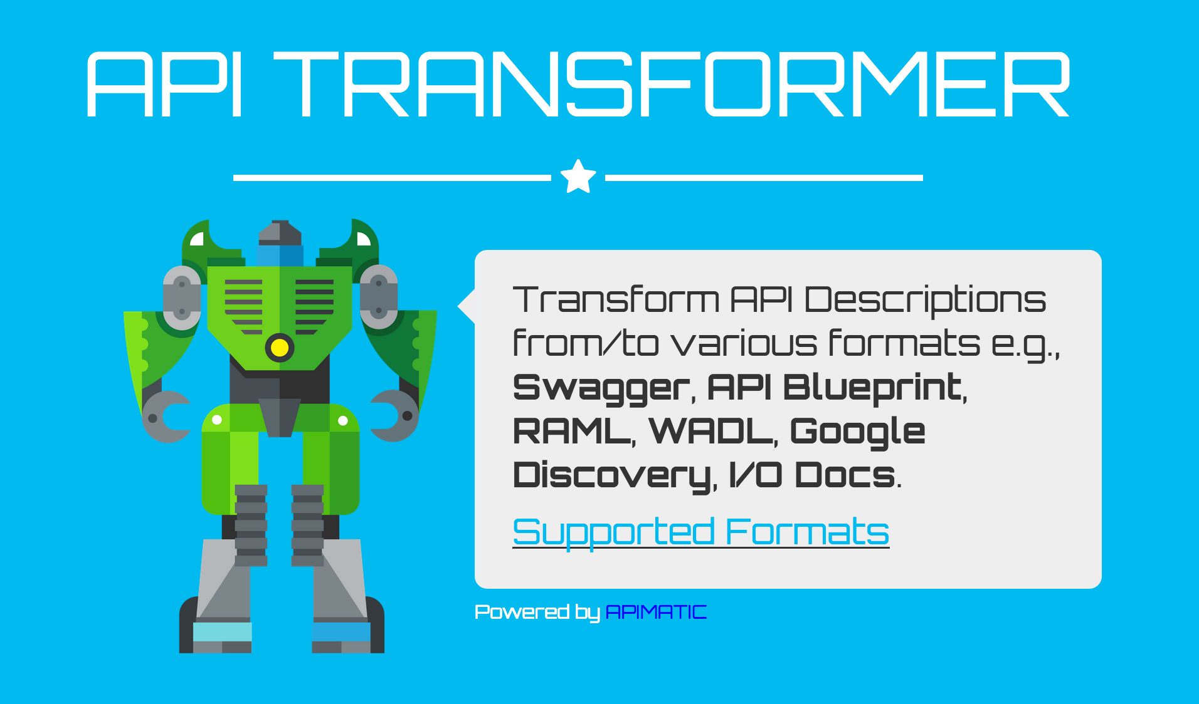
Polyglot!
Notes:
https://apitransformer.com/

Slide 48
Images credit:
http://swagger.io
http://www.miramax.com/subscript/pulp-fiction-celebrating-20-years/
https://en.wikipedia.org/wiki/Night_vision_device
https://maxpreme.wordpress.com/2008/12/08/the-north-face-x-swagger/
https://www.google.co.nz/trends/
http://www.telestar.fr/2014/photos/zach-galifianakis-l-incroyable-perte-de-poids-de-l-acteur-de-very-bad-trip-diaporama-49531
http://mic.com/articles/77505/why-everyone-is-so-mad-about-the-wolf-of-wall-street#.GL46BT50a

